Slide 1

Understanding
xAPI Profiles
Notes:
Stop hardcoding configuration

Slide 2
xAPI by design
is extremely flexible
Notes:
xAPI by design is extremely flexible

Slide 3

FIRED
Tom fired a missile
Tom fired his pottery masterpiece
Tom fired his sous chef
Passed
Tom passed Chem 202
Tom passed checkpoint 1
Tom passed the test
Notes:
FIRED
Tom fired a missile
Tom fired his pottery masterpiece
Tom fired his sous chef
Passed
Tom passed Chem 202
Tom passed checkpoint 1
Tom passed the test

Slide 4

(a)
(b)
(c)
Actor: Tom@example.com
Verb: “completed”
Object: “course 1”
Actor: Tom@example.com
Verb: “Passed”
Object: “course 1”
Actor: Tom@example.com
Verb: “finished”
Object: “course 1”
Result:
Completion: true
Success: true
Notes:
How do I indicate completion?
Actor: tom@example.com
Verb: “completed”
Object: “course 1”
Actor: tom@example.com
Verb: “passed”
Object: “course 1”
Actor: tom@example.com
Verb: “finished”
Object: “course 1”
Result:
Completion: true
Success: true

Slide 5

Started
Scanned
Paused
Stopped
Finished
Play
Fast-forward
Reverse
Pause
Stop
Notes:
Which terms do you use for a video?

Slide 6
Flexibility without consensus prevents interoperability
Notes:
Flexibility without consensus prevents interoperability

Slide 7

When I report
something was ‘fired’
Fired = discharge
Gun or weapon
Notes:
Let’s all agree
When I report
something was ‘fired’
Fired = discharge
Gun or weapon

Slide 8

Play
Fast-
forward
Reverse
Pause
Stop
Started
Scanned
Paused
Stopped
Finished
Played
Paused
Seeked
Terminated
Completed
Video
Progress
Time
Frame-rate
Speed
or
Notes:
Vocabulary
Set of agreed upon terms - verbs, activity types, extensions - to be used by a group or organization.
Ex: http://xapi.vocab.pub/datasets/video/
See: http://xapi.vocab.pub/datasets/adl/
Started
Scanned
Paused
Stopped
Finished
or
Play
Fast-forward
Reverse
Pause
Stop
Played
Paused
Seeked
Terminated
Completed
...
Video
Progress
Time
Frame-rate
Speed
...
Ex: http://xapi.vocab.pub/datasets/video/
See: http://xapi.vocab.pub/datasets/adl/

Slide 9

EX: http://xapi.pub/datasets/ videos
http://xapi.vocab.pub/ datasets/adl/
Notes:
EX: http://xapi.pub/datasets/videos
http://xapi.vocab.pub/datasets/adl/

Slide 10
When I report
completion
The completion value is in the result of a ‘terminated’ statement
Notes:
Let’s all agree
When I report
something was ‘fired’
Fired = discharge
Gun or weapon
Statement order, packaging, other stuff needed to create consistency

Slide 11

Terms
Attempt
Launched
Vocabularies
Video
SCORM
Rules
1st Stmt is
Initialized
Status in
Terminated
Result
Profile
Notes:
Set of rules and guidelines to be used for a group or organization that encompases more than just a vocabulary
Terms
Attempt
Launched
Vocabularies
Video
SCORM
Rules
1st Stmt is Initialized
Status in Terminated Result
Profile
xAPI SCORM Profile: https://github.com/adlnet/xAPI-SCORM-Profile
cmi5: https://github.com/AICC/CMI-5_Spec_Current

Slide 12

Describes interoperable runtime communication between Learning Management Systems (LMS) and Assignable Units (AU).
Uses xAPI statement rules and endpoints to encode learning experiences and to send and retrieve them.
Uses ADL’s vocabulary for verbs and a specific cmi5 vocabulary for extensions
Defines rules for packaging content for import into an LMS
Defines rules for launching content managed by an LMS
Notes:
Describes interoperable runtime communication between Learning Management Systems (LMS) and Assignable Units (AU).
Uses xAPI statement rules and endpoints to encode learning experiences and to send and retrieve them.
Defines rules for packaging content for import into an LMS
Uses ADL’s vocabulary for verbs and a specific cmi5 vocabulary for extensions
Defines rules for launching content managed by an LMS

Slide 13
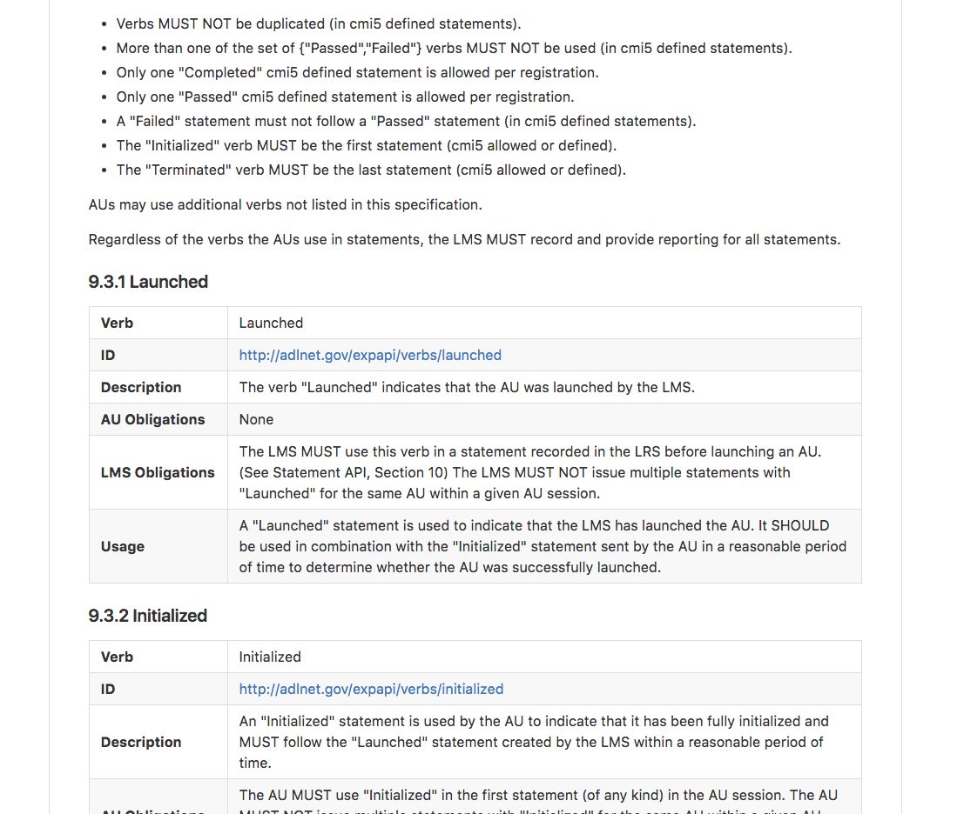
https://github.com/AICC/CMI-5_Spec_Current

Slide 14

Offers guidelines for representing SCORM data and events as Experience API Statements.
Uses xAPI statement rules and endpoints to encode learning experiences and to send and retrieve them
Uses ADL’s vocabulary for verbs and activity types
Defines rules and data types for using the xAPI document endpoints
Leaves hosting, launch and curation of content up to the organization
Notes:
Offers guidelines for representing SCORM data and events as Experience API Statements.
Uses xAPI statement rules and endpoints to encode learning experiences and to send and retrieve them
Defines rules and data types for using the xAPI document endpoints
Uses ADL’s vocabulary for verbs and activity types
Leaves hosting, launch and curation of content up to the organization

Slide 15
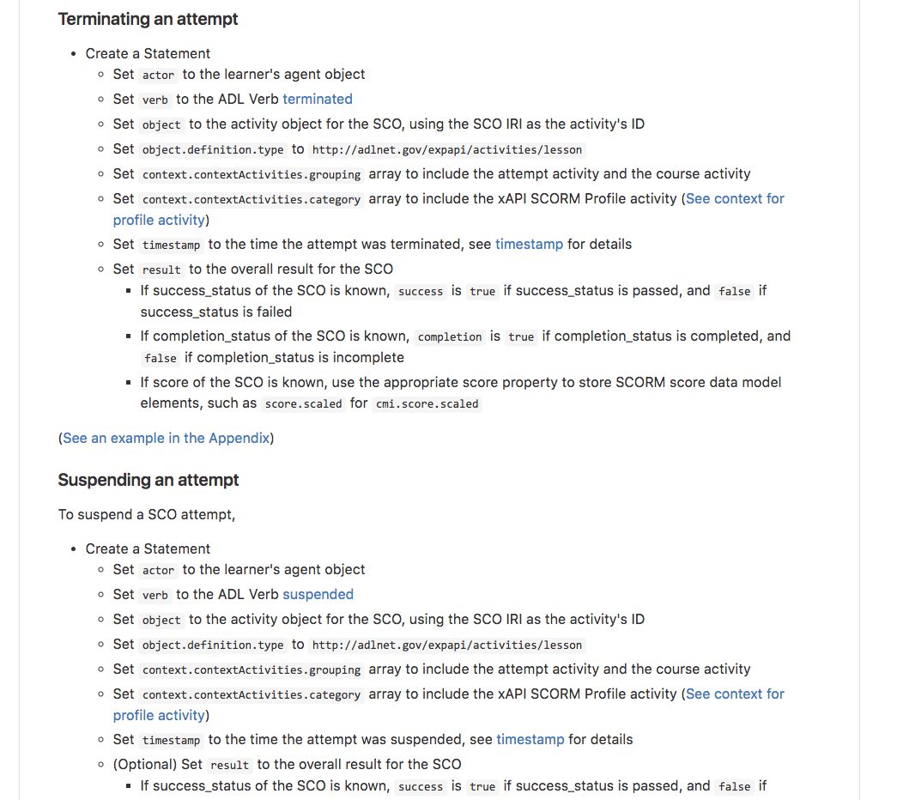
https://github.com/adlnet/xAPI-SCORM-Profile

